Slide 1
Insurance Fraud Analysis and Detection
(Hub Analysis)
Created by – Eyong Divine
Date – June 29, 2022

Slide 2
Agenda
What are Hubs? Points of Interests?
Analysis of Hubs
Drill Down Analysis for Possible Frauds

Slide 3
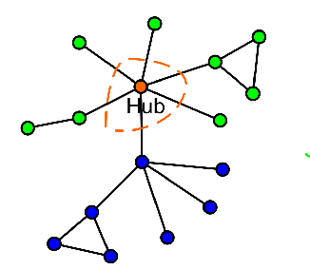
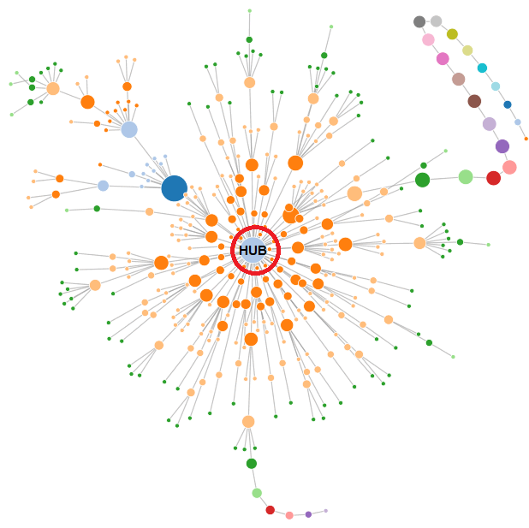
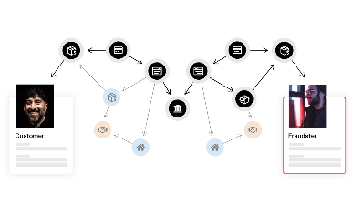
What is Hub?
In network analysis, we have nodes (connected through edges)
There are certain nodes, which have large number of connections (Degree of Node) – These nodes are known as Hubs
There are also some nodes which have small Degree (these can be isolated nodes) – Unique Nodes (or Leaves/ Terminals)
In Graphical Analysis, both types of nodes (Hub and Isolated) can be our points of interest. Hubs shows common issues (frauds/ incidents), while unique nodes can be Anomalies
In details analysis can reveal possible frauds at these nodes

Slide 4
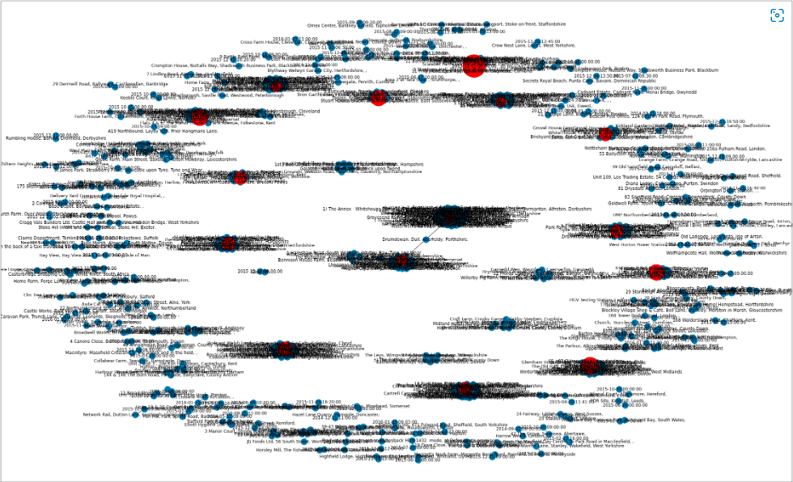
Hub Analysis
As an example, I have explain the following scenario
Address to Incident date plotting – This will tell us the number of incidents occurred on a specific date in a specific location
Now Consider following scenarios

Slide 5
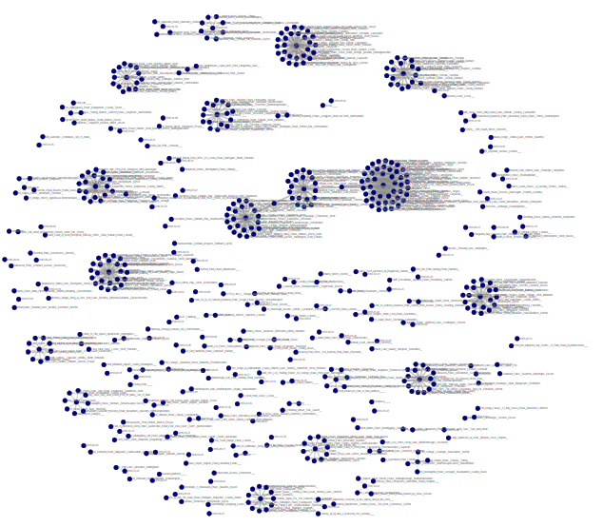
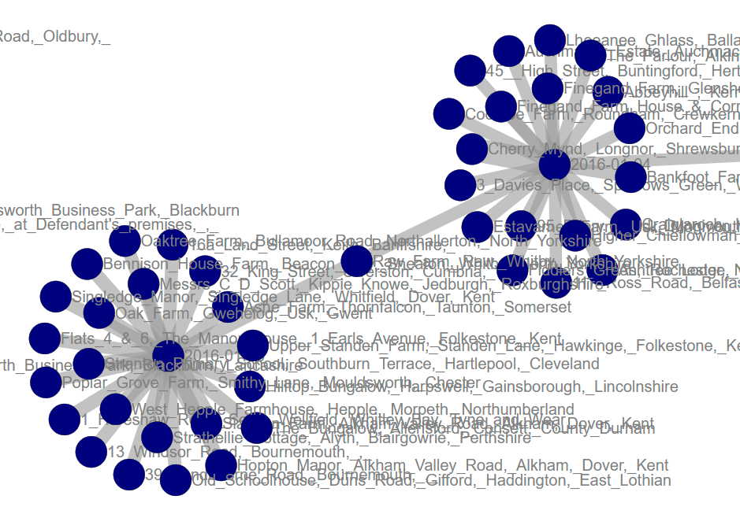
Hub Analysis
Similarly these are HUBs in D3Graph
We called these hubs, because either it will have large number of connections or it will be bridge among two different clusters
We need to study all these hubs in details for fraud detection/ possibility

Slide 6
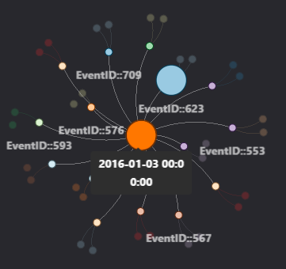
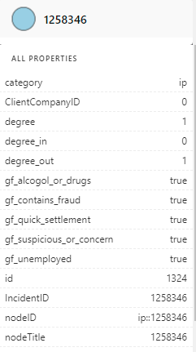
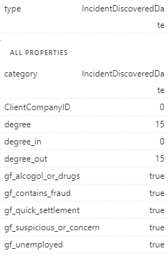
Hub Analysis
Properties of this node
Properties of this Incident

Slide 7
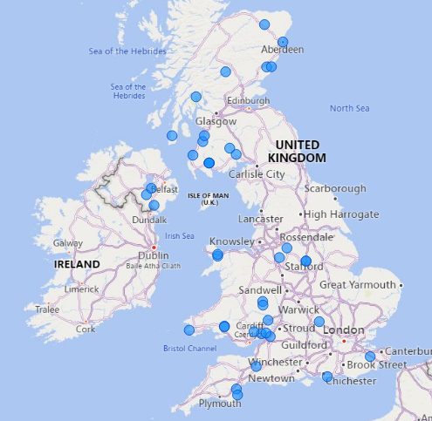
Drill Down of Analysis Hub
Consider these incidents
On this specific date :- 2015-12-30
On 41 following different Addresses 122 incidents occurred

Slide 8
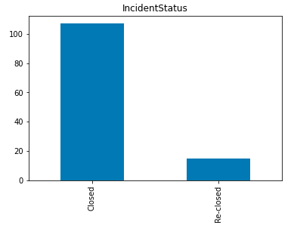
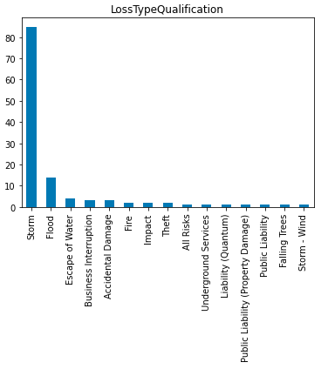
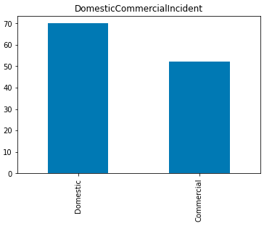
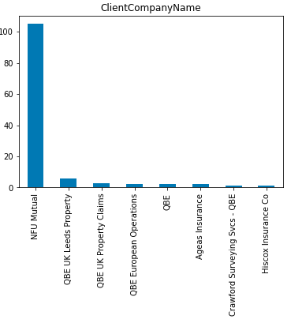
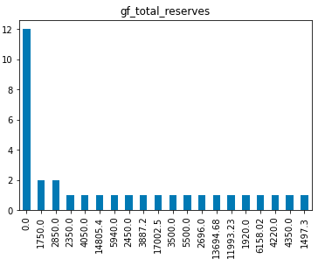
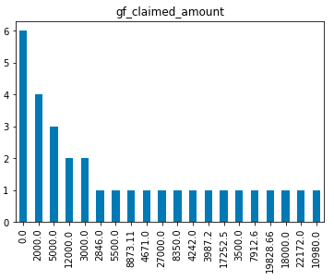
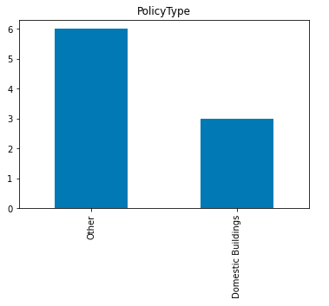
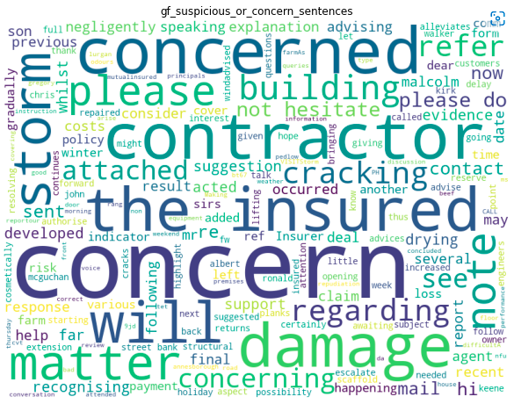
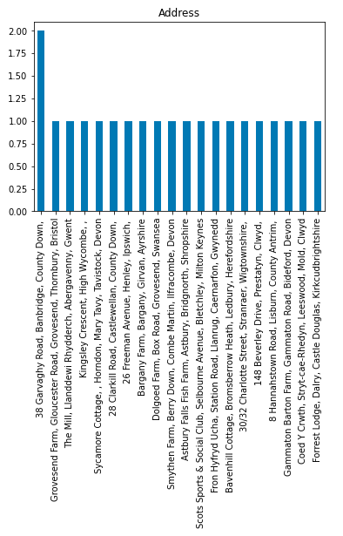
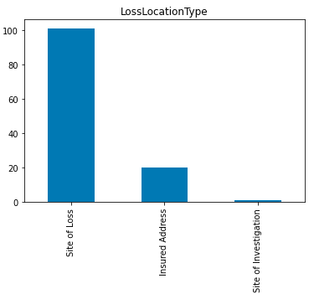
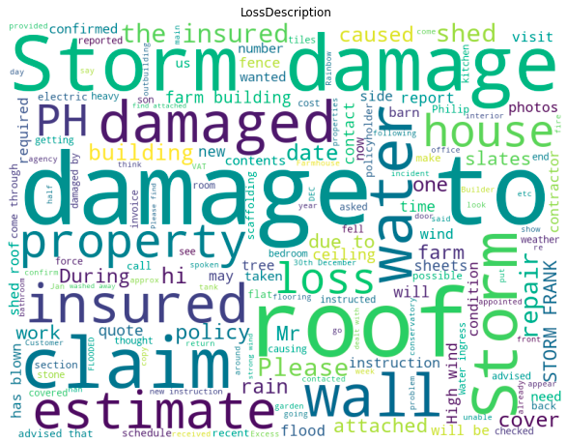
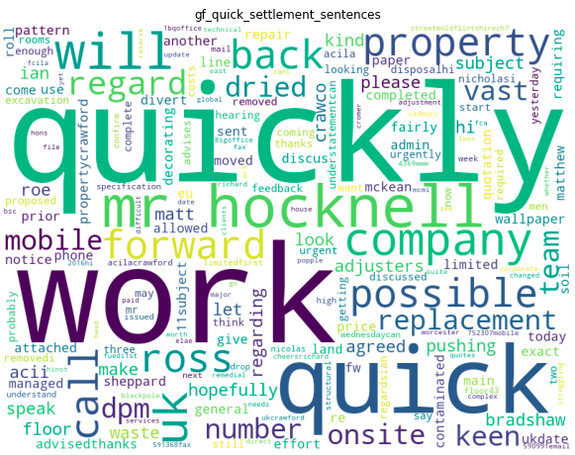
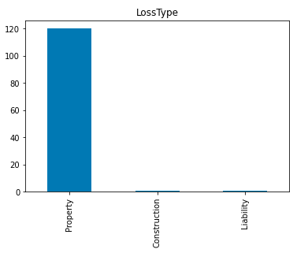
Drill Down Analysis of Hub
Analysis of data on DATE: 2015-12-30

Slide 9
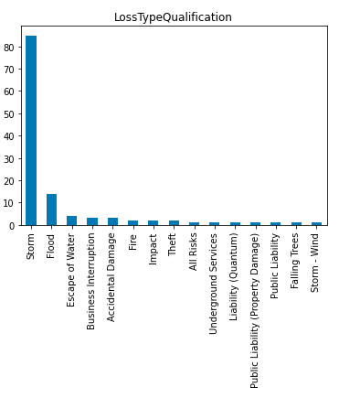
Action(s) After Analysis
After deep analysis, you will end up with some findings and conclusion;
For example for above case, incidents on DATE: 2015-12-30
You can easily find what happened on that specific dates
So, from this case study, we found that on that mostly people reported STORM as incident, you can easily validate that
For those events which are rare such as FIRE, Theft etc in given scenario can also be analyzed – by verifying the incident location and GPS/ Tracker location of Policy Holder/ Property
In this way, one can easily conclude the incidents as normal or fraud

Slide 10
Thank you

